Slide 1
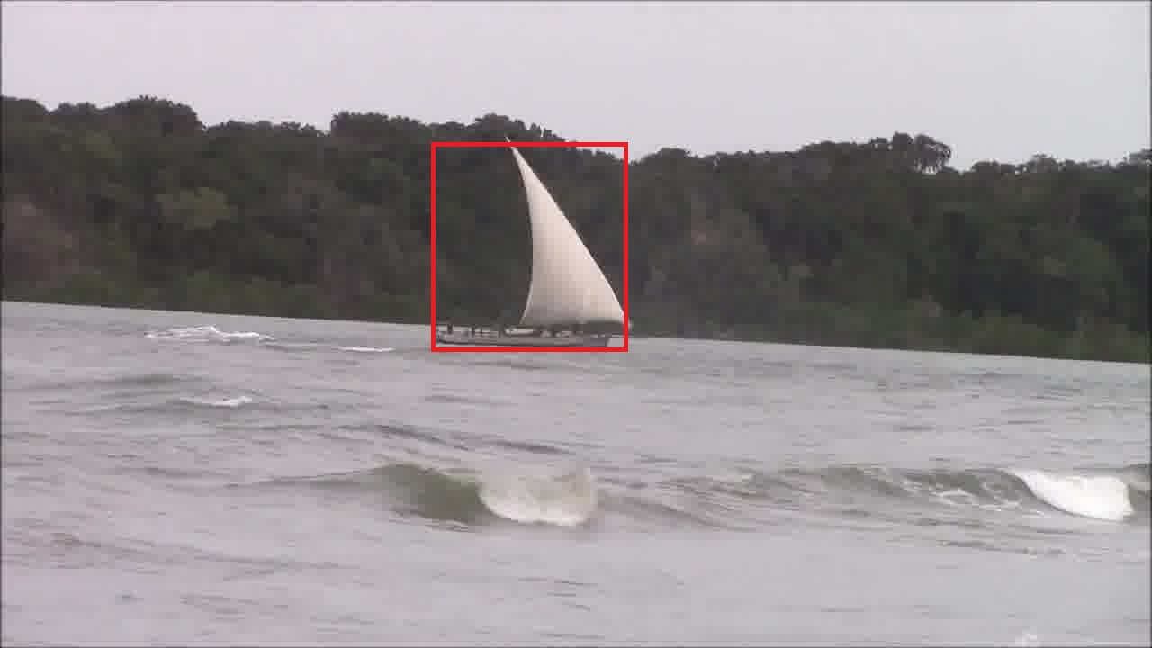
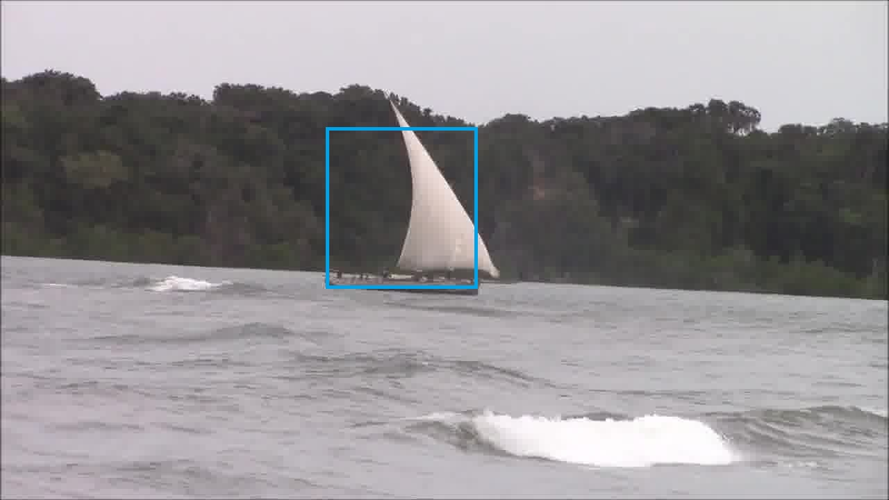


Prediction Head
Prior Box
$$T−1$$
$$T$$

